Slide 1
War Memorials
how we commemorate wars

Slide 2
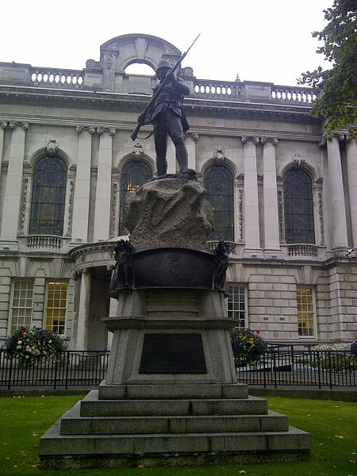
Boer War Memorial, Belfast

Slide 3
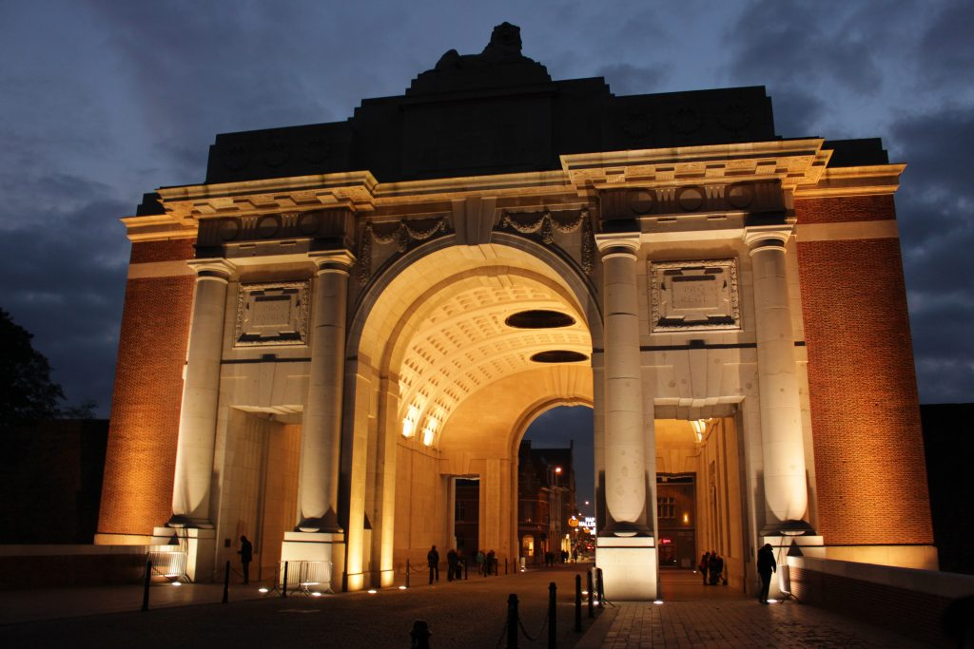
The Menin Gate, Ypres

Slide 4
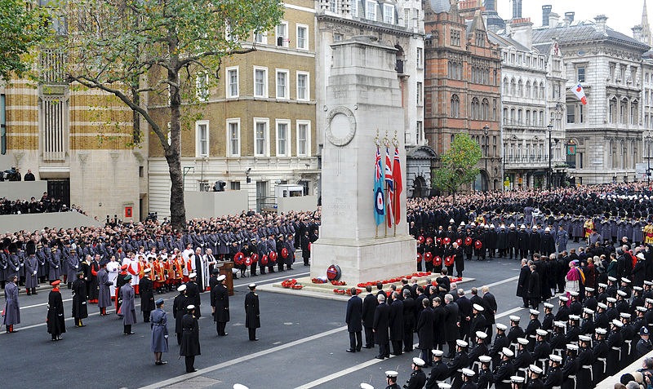
The Cenotaph, London

Slide 5
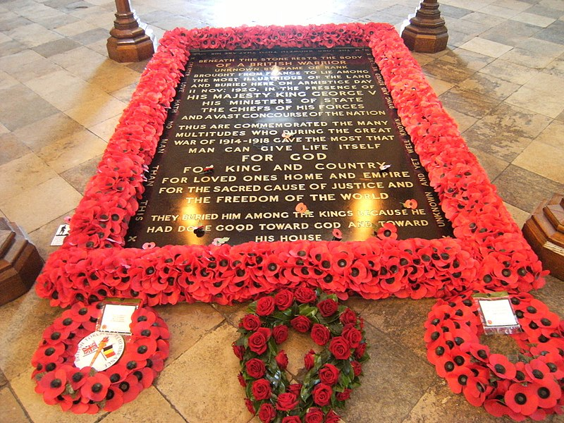
The Tomb of the Unknown Warrior, Westminster Abbey

Slide 6
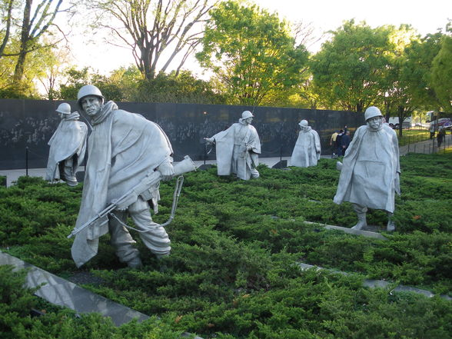
Korean War Veterans Memorial, Washington DC

Slide 7
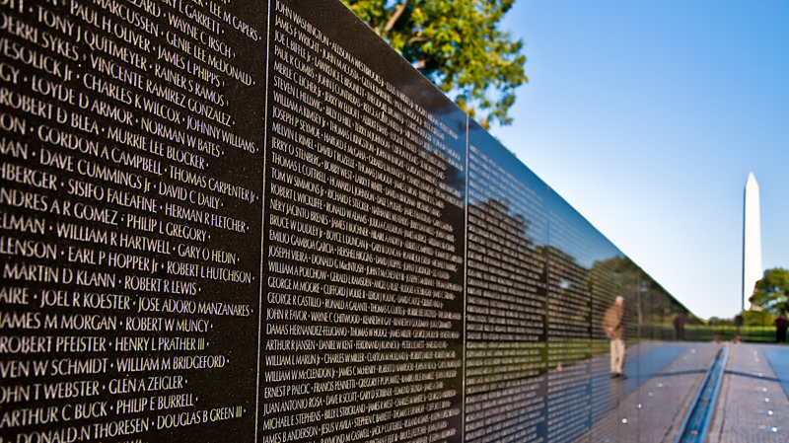
Vietnam Veterans Memorial Wall, Washington DC

Slide 8
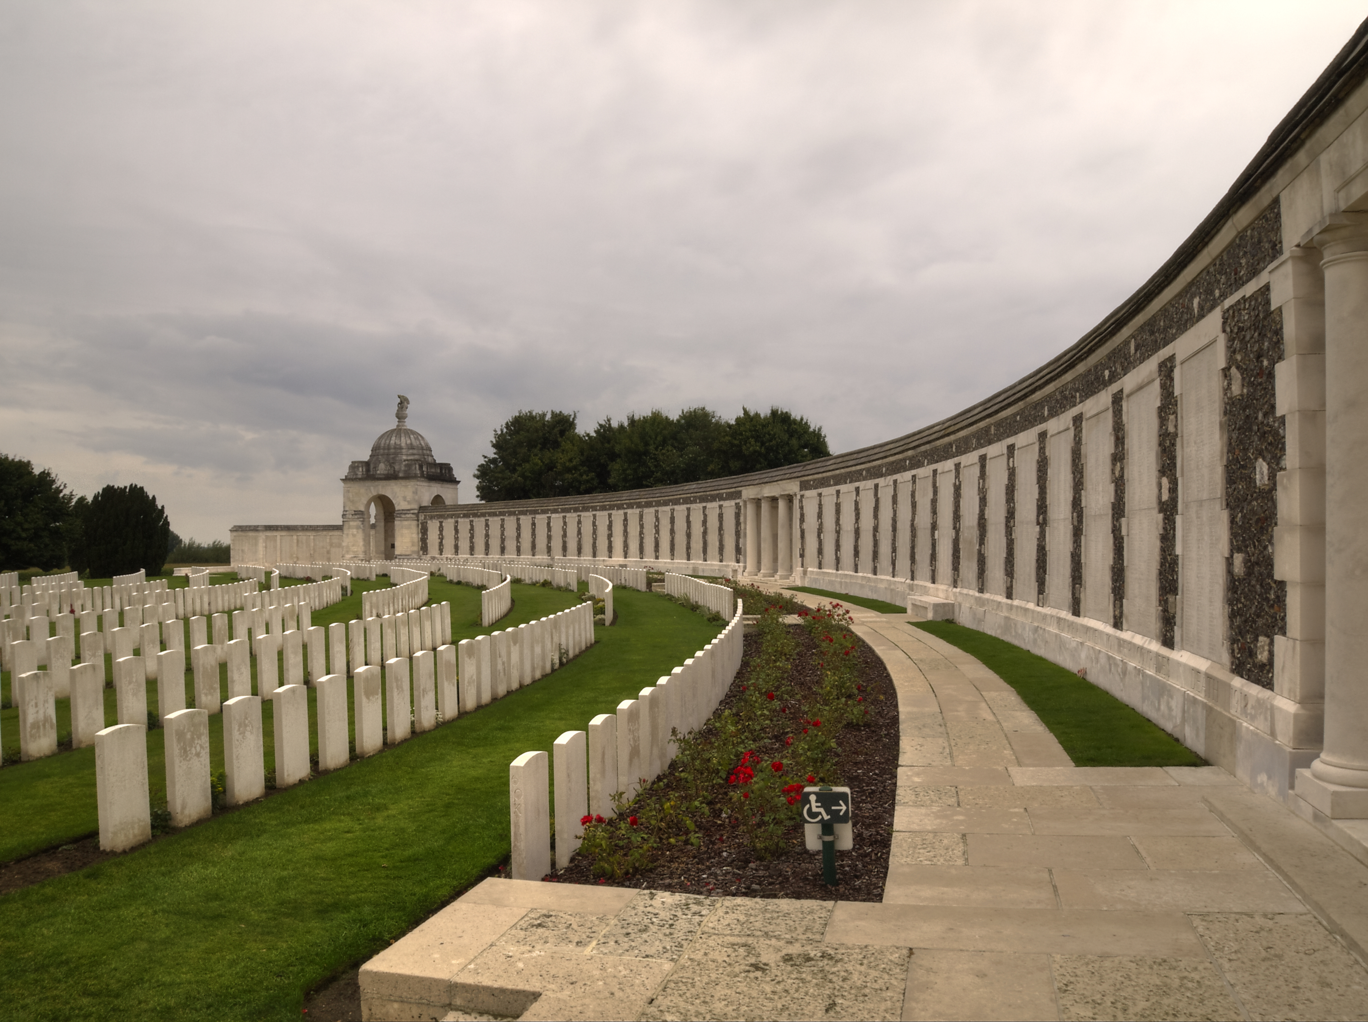
Tyne Cot Cemetary, Belgium

Slide 9
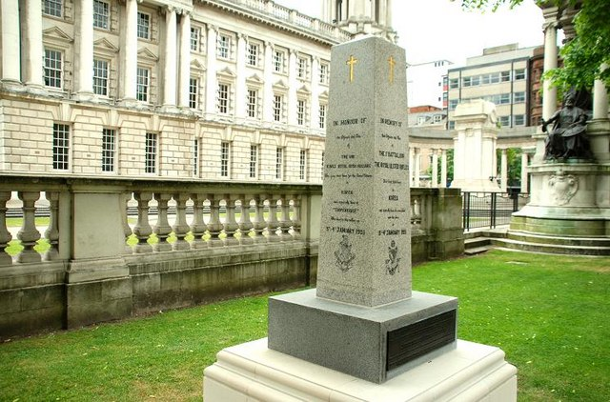
Korean War Memorial, Belfast

